Slide 1



UBER VS LYFt
Georgia tech Data Science Boot Camp
By Meryam, AdriEnne, Hakan and Saira

Slide 2
INTRODUCTION
Purpose of the Project
Uber & lyft Analysis to Different Destinations in Atlanta
Working with Categorical Data
Dummy Encoding (Binary Encoded Data)
RegrEssion Models
Q&A

Slide 3
Purpose of the Project
Uber vs Lyft pricing
Lyft vs Uber Vehicle options
Lyft vs. Uber Coverage Areas

Slide 4
Uber vs Lyft pricing
Lyft and Uber are constantly in competition with an agenda to lure, more customers to either of their side by offering cheap and low priced rides 🤑.
An in-depth Uber vs Lyft rates review shows that these companies have almost the same pricing, although prices can change from city to city. To start a ride, both companies charge one dollar and then 1.50 dollars per mile plus additional booking fees.
After computing these costs together you find that it comes to $2.00 per mile which by far is cost-effective in comparison to a taxi although charges may change in large cities. Check Uber's most expensive cities versus the cheapest cities to get an overview.

Slide 5
Uber & lyft Analysis to Different Destinations in Atlanta
In this analysis, we collected uber & Lyft data for 20 frequently visited destinations in Atlanta, Georgia. We were able to collect data using Uber-rides and Lyft-rides. Using this data, we created an interactive web-page to show the estimated costs and duration for different types of ubers and Lyft.

Slide 6
Working with Categorical Data
Machine Learning algorithms work with numerical data. We have to convert our strings into meaningful numbers. We often use Integer, One-hot, or Binary Encoding. Sklearn provides a preprocessing libarary for all of these standard preprocessing techniques. Pandas also provides a get_dummies method that is useful to generate binary encoded data from a Data Frame.

Slide 7
Dummy Encoding (Binary Encoded Data)
Dummy Encoding transforms each categorical feature into new columns with a 1 (True) or 0 (False) encoding to represent if that categorical label was present or not in the original row.
Pandas provides a shortcut to create Binary Encoded data.

Slide 8

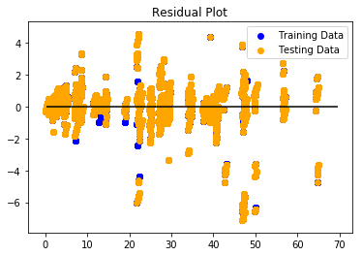
Distance Prediction with Linear Regression
Linear regression Uber
Training Score: 0.9968660670564958
Testing Score: 0.9968428254165403

Slide 9
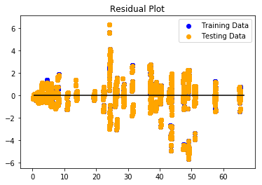
Distance Prediction with Linear Regression
Linear regression LYFT
Training Score: 0.9975648489130104
Testing Score: 0.9975982430315888

Slide 10
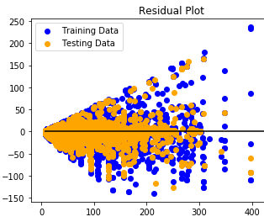
Random Forest Regressor
Training Score: 0.9808436516928598
Testing Score: 0.9821054331005403

Slide 11
sort the features by their importance
[(0.6278354136958626, 'dist’),
(0.1703502160339029, 'display_name_Black SUV'),
(0.07507474164260948, 'display_name_Black'),
(0.04979394542214622, 'display_name_UberXL'),
(0.03374279540739712, 'display_name_Select'),
(0.013911088363991029, 'time_15:00'),
(0.013793910792515116, 'time_16:00'),
(0.00721862447160578, 'time_17:00'),
(0.0030309703147913935, 'place_Forsyth'),
(0.002476348886736381, 'time_18:00'),
(0.0006508640355826689, 'time_14:00'),
(0.000556679050365629, 'place_Coweta'),
(0.00030526377988722333, 'place_Bartow'),
(0.0001261383587801806, 'place_Paulding'),

